Slide 1
Outline:
Day 1: A biologically motivated python exercise (writing a simulator)
Day 2: Performing simulations at scale and comparing them to data (detecting positive selection)
Day 3: An introduction to machine learning and deep learning (machine learning exercise)
Day 4: Applications of machine learning to evolutionary genetics (detecting positive selection via deep learning)

Slide 2
Outline:
Day 1: A biologically motivated python exercise (writing a simulator)
Day 2: Performing simulations at scale and comparing them to data (detecting positive selection)
Day 3: An introduction to machine learning and deep learning (machine learning exercise)
Day 4: Applications of machine learning to evolutionary genetics (detecting positive selection via deep learning)

Slide 3
Part 2: simulating populations and detecting positive selection
Dan Schrider
UFPR
2024

Slide 4
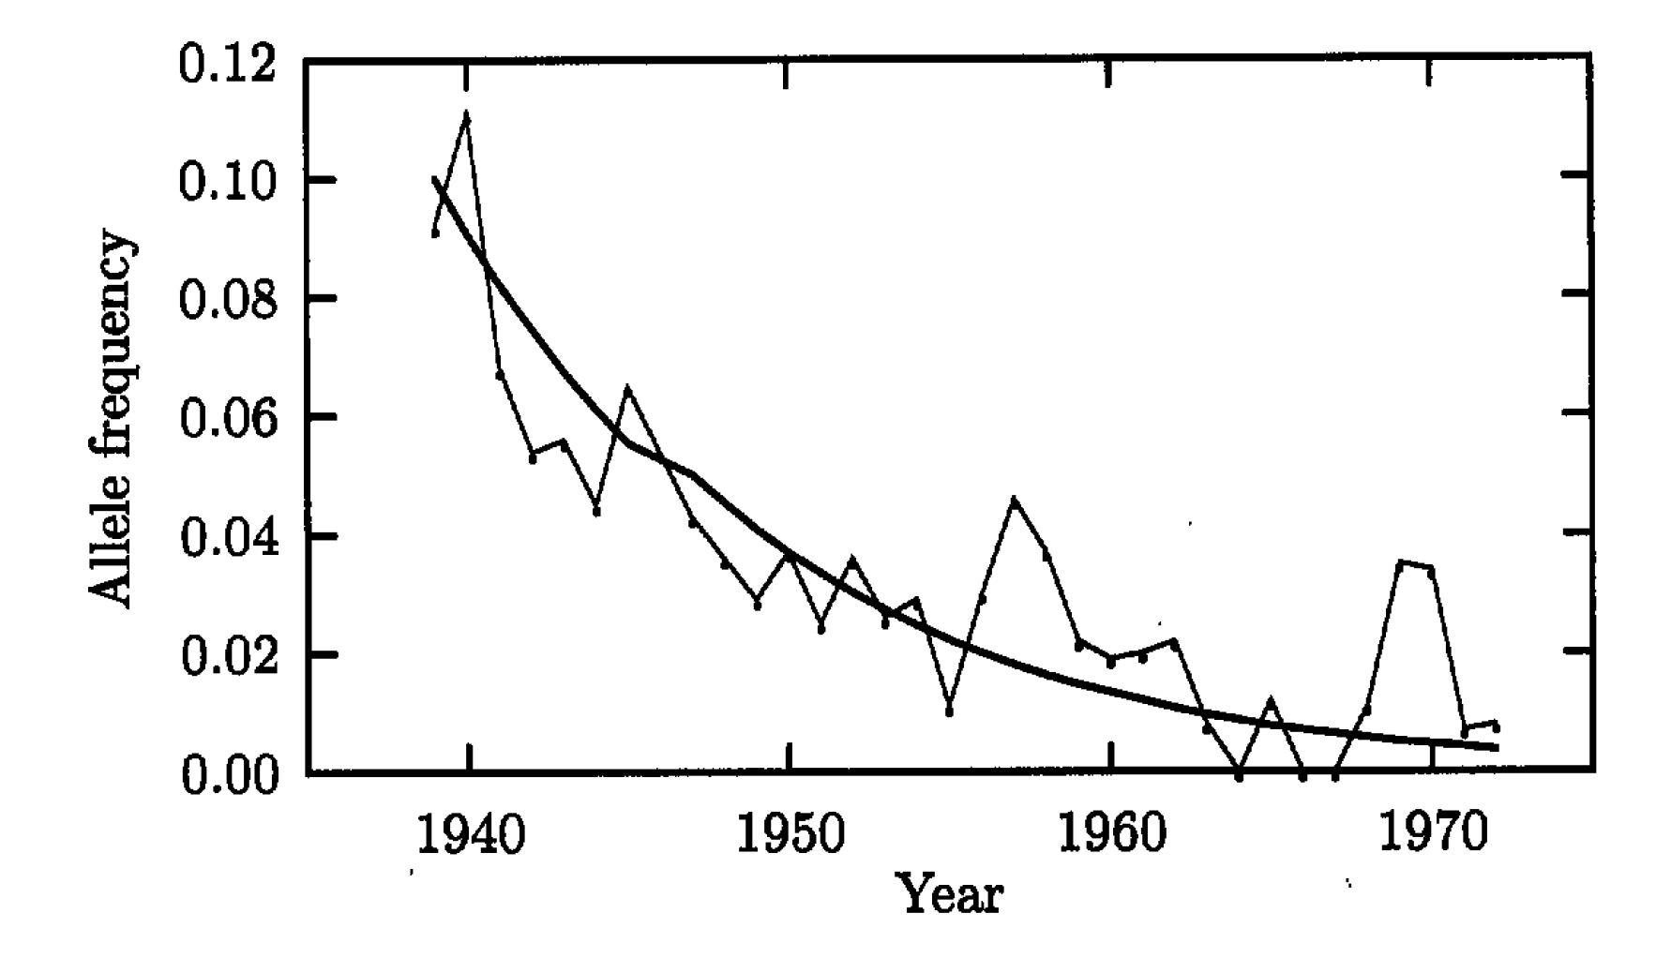
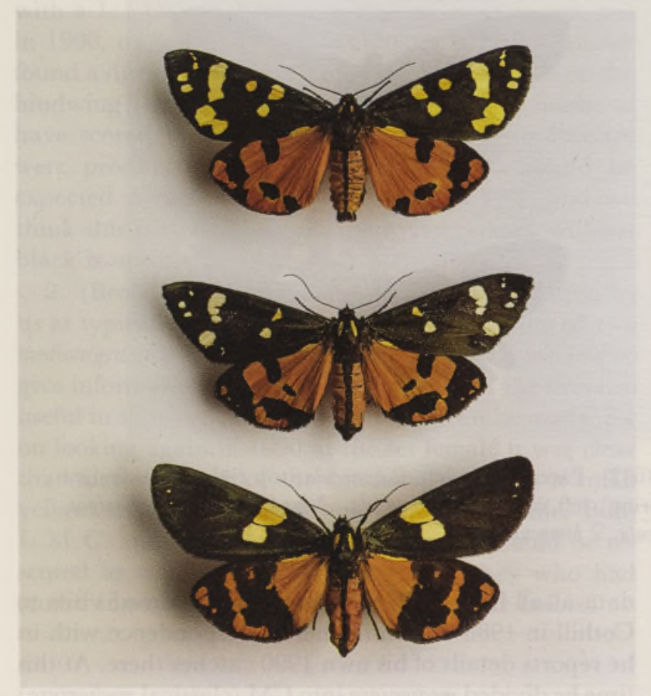
Frequency of medionigra allele in the European scarlet tiger moth
Can we infer whether this trend is driven by natural selection?

Slide 5
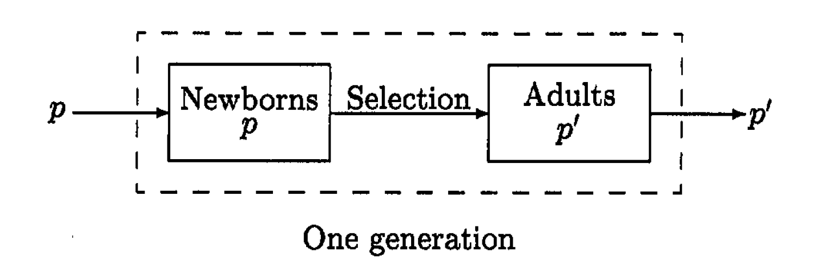
Fundamental model of selection

Slide 6
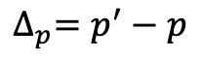
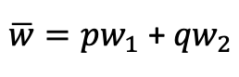
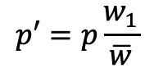
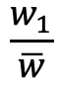
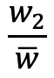
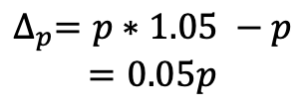
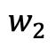
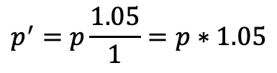
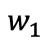
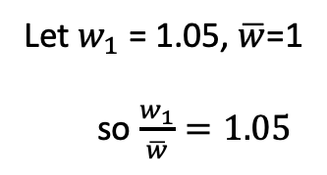
Allele frequency change in the fundamental model of selection
Fitness of A₁ allele:
$$w_{1}$$
Fitness of A₂ allele:
$$w_{2}$$
Mean population fitness:
$\overline{w}=pw_{1}$ + ${qw}_{2}$
Let $w_{1}$ = 1.05, $\overline{w}$=1
so $\frac{w_{1}}{\overline{w}}=1.05$
Relative fitness of A₁, A₂ alleles:
$$\frac{w_{1}}{\overline{w}}$$
$$\frac{w_{2}}{\overline{w}}$$
,
Frequency of A₁ in the next generation:
$$p′=p\frac{w_{1}}{\overline{w}}$$
$$p^{′}=p\frac{1.05}{1}=p∗1.05$$
Per-generation change in frequency of A₁:
$${∆_{p}=p}^{′}−p$$
$$∆_{p}=p∗1.05 −p$$
$$=0.05p$$

Slide 7
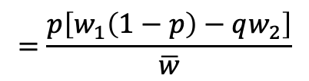
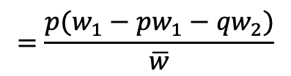
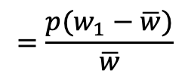
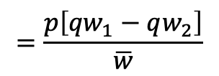
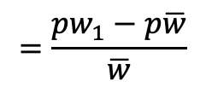
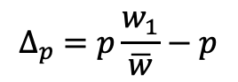
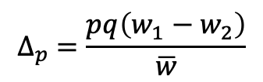
Allele frequency change in the fundamental model of selection
$$∆_{p} =p\frac{w_{1}}{\overline{w}}−p$$
Fitness of A₁ allele:
$$w_{1}$$
$$=\frac{{pw}_{1}−p\overline{w}}{\overline{w}}$$
Fitness of A₂ allele:
$$w_{2}$$
$$=\frac{{p(w}_{1}−\overline{w})}{\overline{w}}$$
Mean population fitness:
$\overline{w}=pw_{1}$ + ${qw}_{2}$
$$=\frac{{p(w}_{1}−pw_{1}−{qw}_{2})}{\overline{w}}$$
Relative fitness of A₁, A₂ alleles:
$$\frac{w_{1}}{\overline{w}}$$
$$\frac{w_{2}}{\overline{w}}$$
,
$$=\frac{p\left[w_{1}\left(1−p\right)−qw_{2}\right]}{\overline{w}}$$
Frequency of A₁ in the next generation:
$$p′=p\frac{w_{1}}{\overline{w}}$$
$$=\frac{p\left[{qw}_{1}−qw_{2}\right]}{\overline{w}}$$
Per-generation change in frequency of A₁:
$${∆_{p}=p}^{′}−p$$
$$∆_{p} =\frac{pq\left(w_{1}−w_{2}\right)}{\overline{w}}$$

Slide 8
The allele frequency trajectory of a beneficial mutation
(in generations)

Slide 9
But what about genetic drift?
Generation 1
Generation 2
Allele frequencies change even in the absence of selection
The magnitude of these changes is determined by the population size
This is just binomial sampling! (Var[p’] = Var[2Np’]/(2N)² = p(1 − p)/2N
The model we just showed has no N, and therefore no drift!
…
…

Slide 10
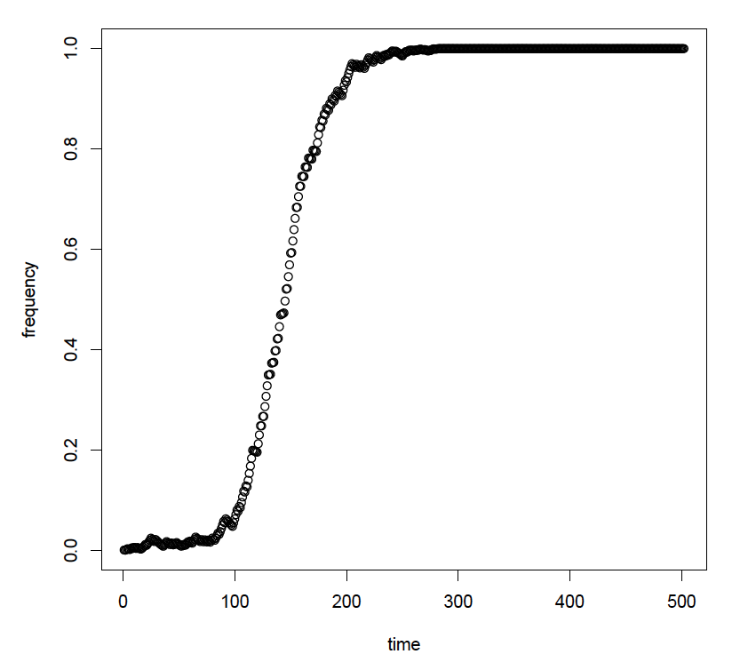
Selection + Drift
And most new beneficial alleles will never make it this far…
P(fixation) = ~2s
Notes:
Let’s take a look in GillespieLand!

Slide 11
Detecting natural selection in the genome
What if all we have is genomic data from one time point?

Slide 12
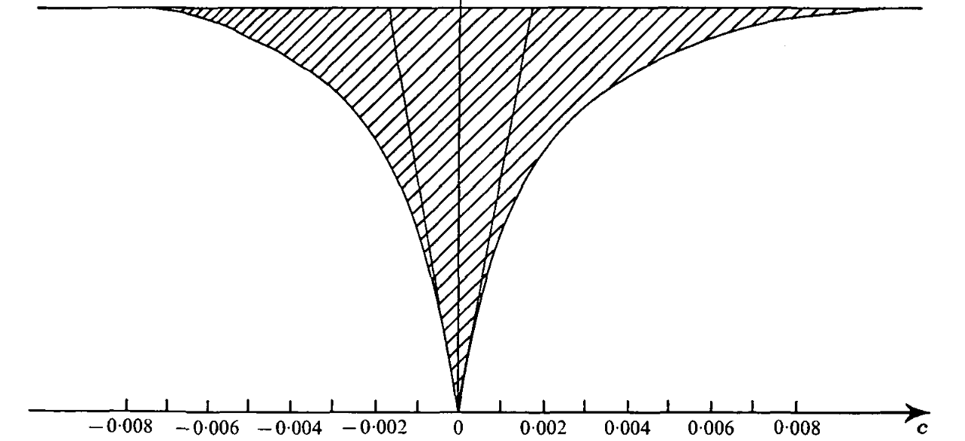
But, a single adaptive fixation has a profound effect on diversity
Maynard Smith and Haigh (1974)

Slide 13
Sweeps produce low- and high-frequency derived alleles

Slide 14
One way to find sweeps: use the SFS
Compare the allele frequencies surrounding a focal site to those expected under neutrality.
In humans: positive selection on pigmentation, central nervous system development, immune function, olfactory receptors, and more
Nielsen et al. (2005), Williamson et al. (2007)

Slide 15
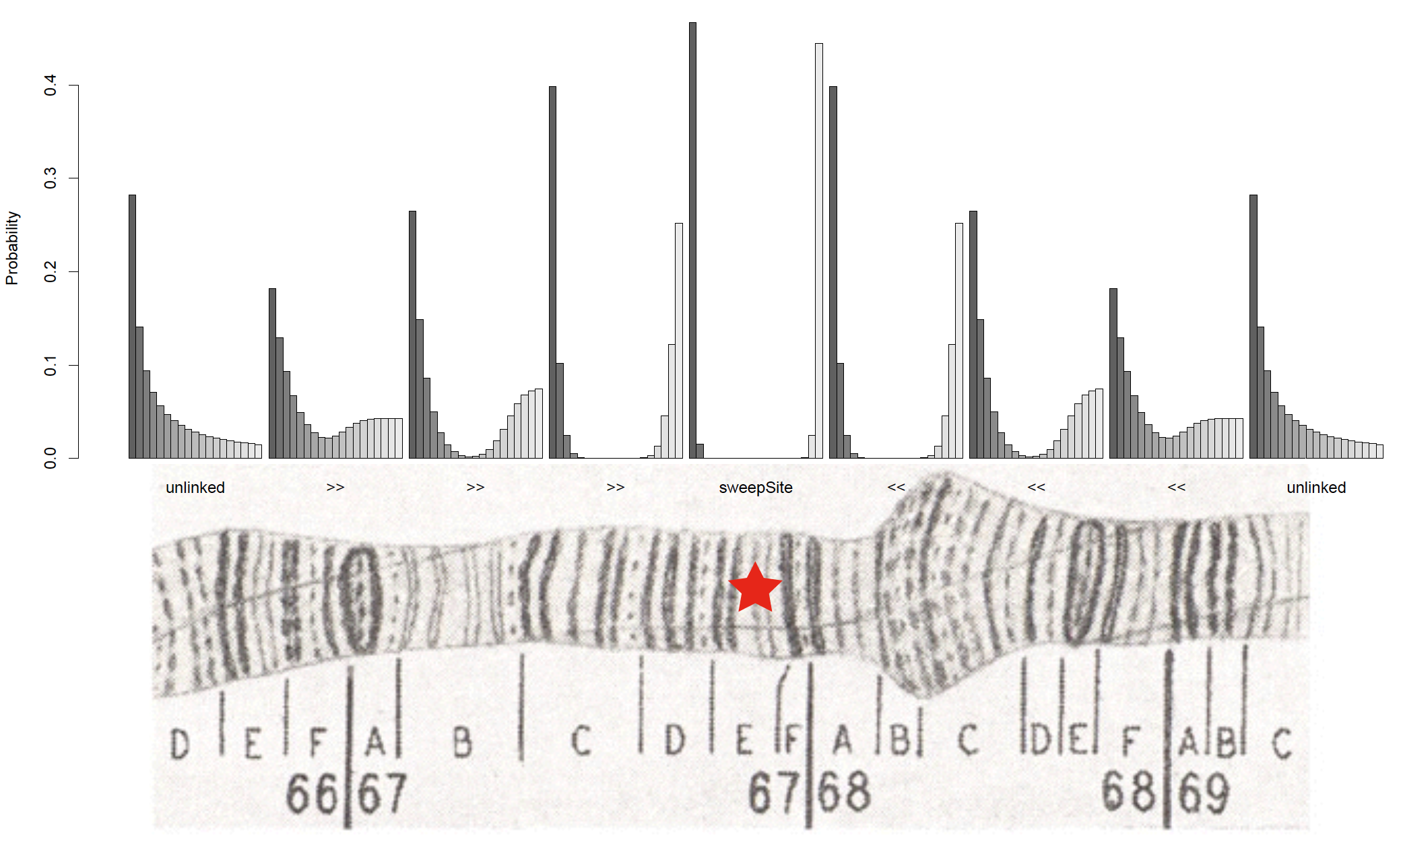
SweepFinder!
Nielsen et al. (2005)

Slide 16
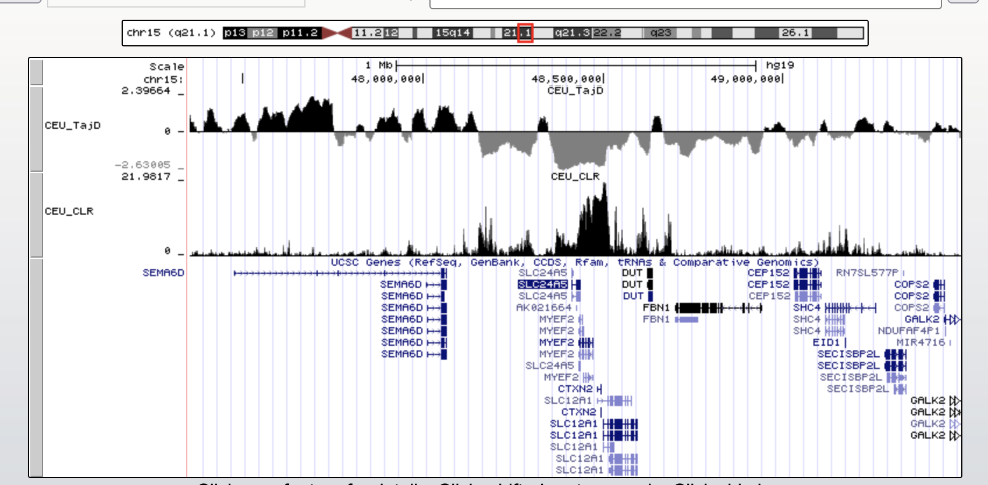
Strong selection on skin pigmentation in Europeans

Slide 17
Recent local adaptation
Very recent selection may cause allele frequencies to differ among populations
This could tells us about how selective pressures/responses differ across populations

Slide 18
F_{ST} and local adaptation
(π_{Tot} – π_{Within}) / π_{Tot}
Population 1
Population 2

Slide 19
F_{ST} and local adaptation
(π_{Tot} – π_{Within}) / π_{Tot}
Accelerated evolution in population 2
Population 1
Population 2

Slide 20
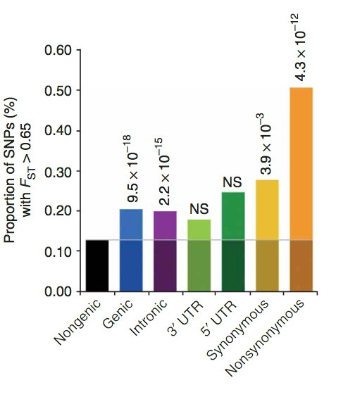
Elevated F_{ST} at nonsynonymous sites in humans
Barreiro et al. (2008)

Slide 21
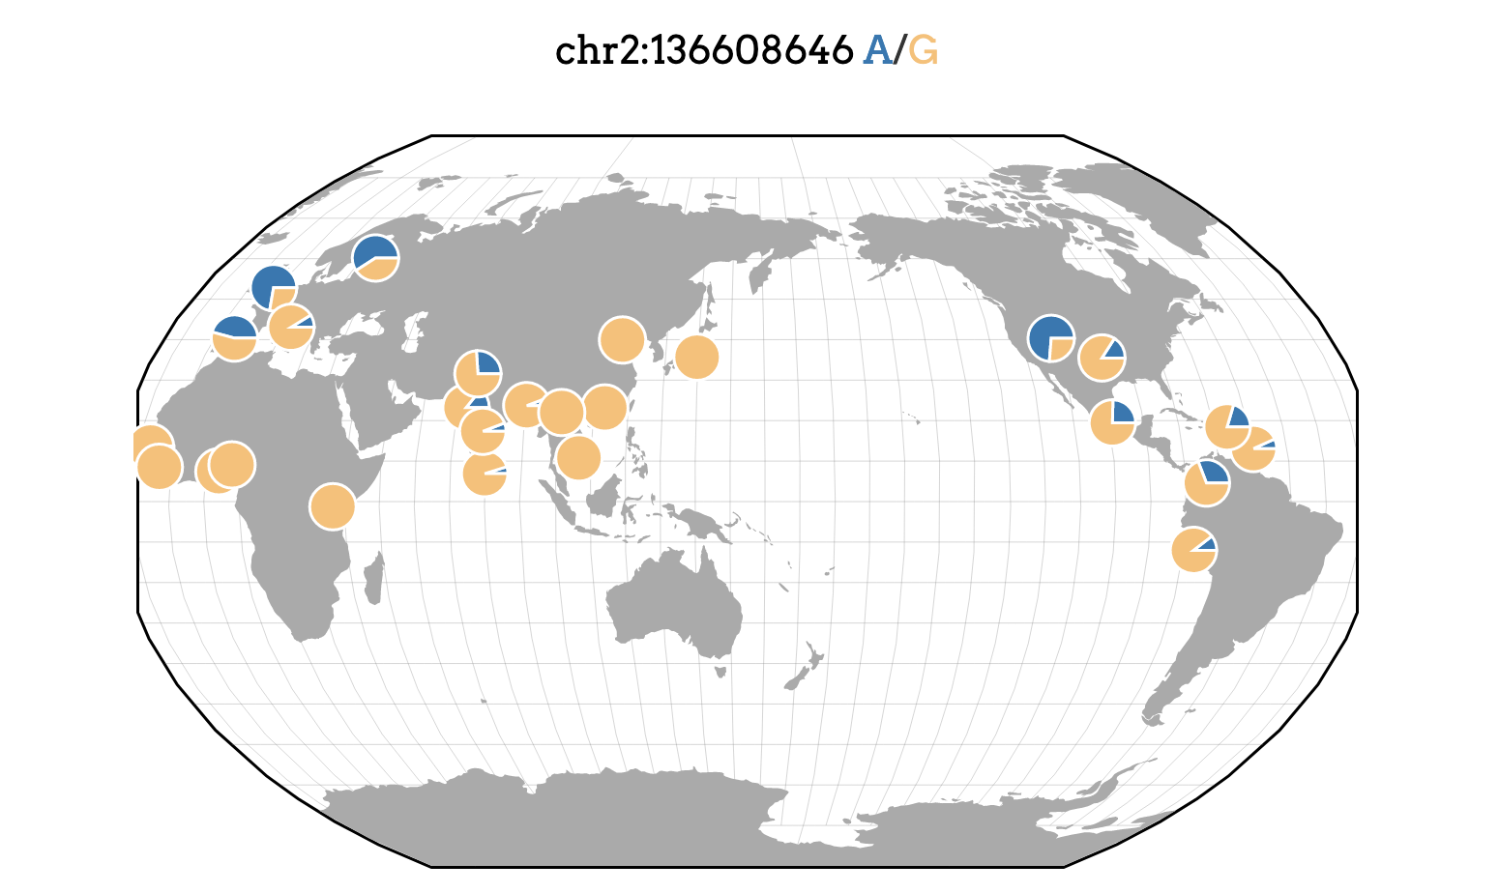
Elevated F_{ST} at a lactase persistence SNP
Assembly version: hg19
https://popgen.uchicago.edu/ggv/

Slide 22
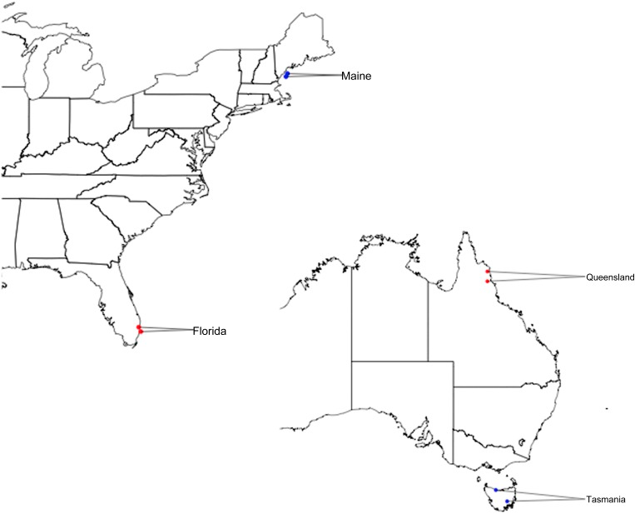
Local adaptation in Drosophila
Reinhardt et al. (2014)

Slide 23
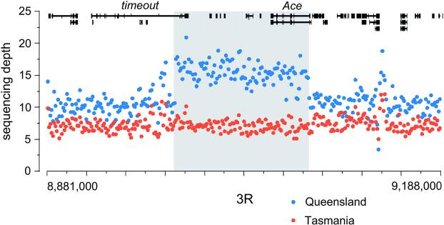
A massive duplication differentiated between Queensland and Tasmania
~100 kb

Slide 24
Ongoing selective sweeps
Sweeps happen quickly, but if they occur often we could potentially catch some in the act!
Hudson et al. (1994), Sabeti et al. (2001), Voight et al. (2006), Ferrer-Admetlla et al. (2014)

Slide 25
Ongoing selective sweeps
Hap div(x): probability that any two haplotypes bearing the x allele differ
Haplotype diversity(der)
Haplotype diversity(anc)

Slide 26
Sweeps produce a lower relative haplotype diversity ratio
Hap div(x): probability that any two haplotypes bearing the x allele differ
Haplotype diversity(der)
Haplotype diversity(anc)

Slide 27
Note: Haplotype diversity ratios must correct for allele frequency
No selection, high haplotype diversity ratio
No selection, low haplotype diversity ratio

Slide 28
Fin

Slide 30
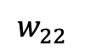
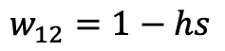
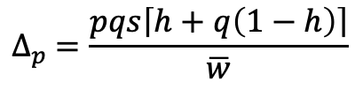
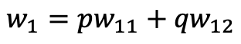
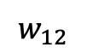
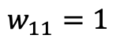
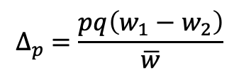
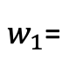
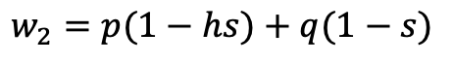
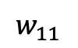
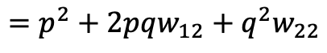
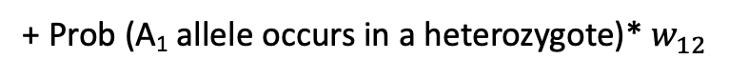
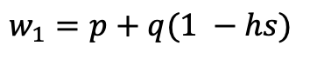
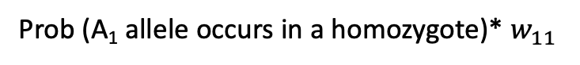
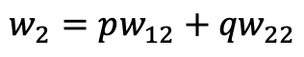
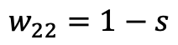
Selection in diploids
$$∆_{p} =\frac{pq\left(w_{1}−w_{2}\right)}{\overline{w}}$$
$$w_{11}$$
: fitness of A₁A₁ individuals
$w_{1}$=
Prob (A₁ allele occurs in a homozygote)* $w_{11}$
$$w_{12}$$
: fitness of A₁A₂ individuals
+ Prob (A₁ allele occurs in a heterozygote)* $w_{12}$
$$w_{22}$$
: fitness of A₂A₂ individuals
$$w_{1}=pw_{11}+{qw}_{12}$$
$$w_{2}=pw_{12}+{qw}_{22}$$
$$\overline{w}=p\left(pw_{11}+{qw}_{12}\right)+q\left(pw_{12}+{qw}_{22}\right)$$
$$=p^{2}+2pqw_{12}+q^{2}w_{22}$$
s: selection coefficient
h: dominance coefficient
h=0.5 : additive/codominant
h=0: A₁ is dominant
h=1: A₁ is recessive
h < 0, s > 0: A₁ is overdominant
h > 1, s > 0: A₁ is underdominant
$$w_{11}=1$$
$$w_{1}=p+q(1 −hs)$$
$$w_{12}=1−hs$$
$$w_{2}=p(1−hs)+q(1−s)$$
$$w_{22}=1−s$$
$$∆_{p} =\frac{pqs\left\lceil h+q\left(1−h\right)\right\rceil }{\overline{w}}$$

